Slide 1
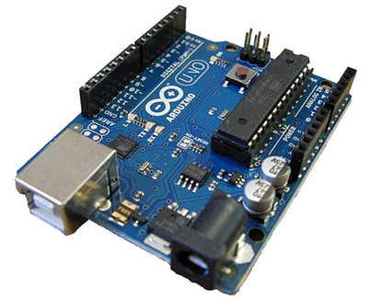
I am Arduino!
나는 아두 이노입니다
Please team up with other participants and form a team of three
Request one parent to volunteer to join & assist the team if the members are below Grade 6
मैं अरदुनओ हूँ
我的Arduino!
Sono Arduino!
Ik ben Arduino!
Je suis Arduino
Notes:
Intro – 10 minutes
Activity #1 – 30 minutes 45
Activity #2 Introduction – 10 minutes
Activity #2 Building – 25 minutes
Activity #2 Explain code – 10 minutes 90
Demo - 15

Slide 2

Start the journey to Internet of Things with Arduino
Pradeep Bhatter
@Pbhatter, pbhatter@yahoo.com
Notes:
Introduction
Kids: Grade level, Programming experience, Electric & Electronic circuits
https://www.youtube.com/watch?v=VQj71FWk1FA Harold Robins Help!
https://www.youtube.com/watch?v=PdBvBtdbQpw 3 Stoogies
https://www.youtube.com/watch?v=l-gQLqv9f4o pep talk

Slide 3
Ground rules
Participate and enjoy; Share, work as a team.
Be Safe! Components can become really hot if incorrectly connected in certain ways.
Getting attention: If your team needs help, please raise you hand and let me know.
I might ask you to tilt and lower the laptop screen at some points so I can have you complete attention.
Each participant gets to take a kit with home. Thank you O’Reilly Media!
We hope you will play with it and one day we will see gadgets and art you create on the web.

Slide 4
Copy of this presentation is on the …..
Computer
Use to catch up if you need additional time for some steps or go ahead of the group
It is in the folder on your desktop -“2014 OSCON IOT Workshop”
Internet
http://bit.ly/2014-OSCON-IOT

Slide 5
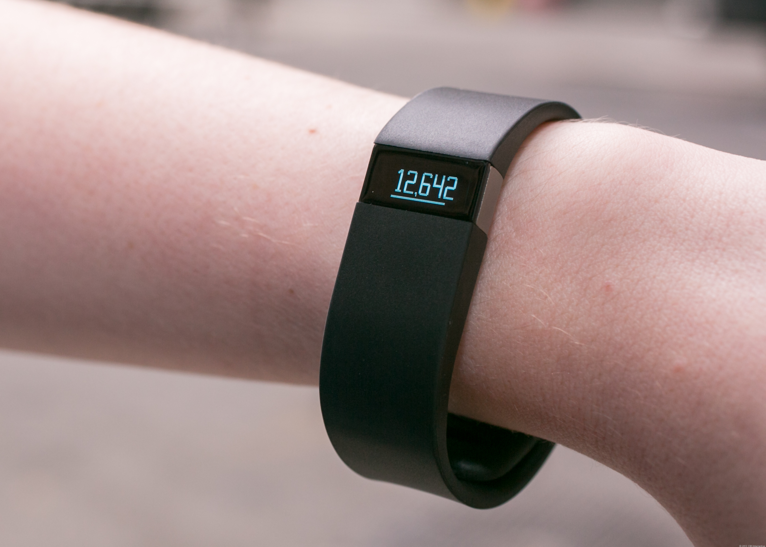
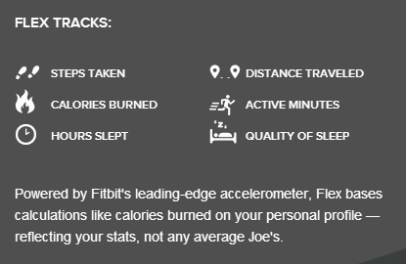
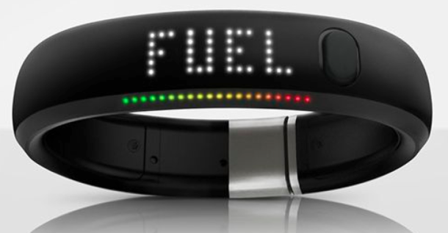
New device ….

Slide 6

Have you seen this one ….

Slide 7
What are we going to do today?
Make a light with a switch and a dimmer
Make a smart light that glows when it is dark using Arduino.
Have fun …
Check out a device I have built, if we have time.

Slide 8
Let us make our first device
What?
a light with a switch and dimmer
Why?
To understand Circuit, Electricity, Current, Voltage , Resistance
Most devices interact with the environment use these concepts
How?
Follow the 5 steps I explain next with me.
Notes:
00:10

Slide 9
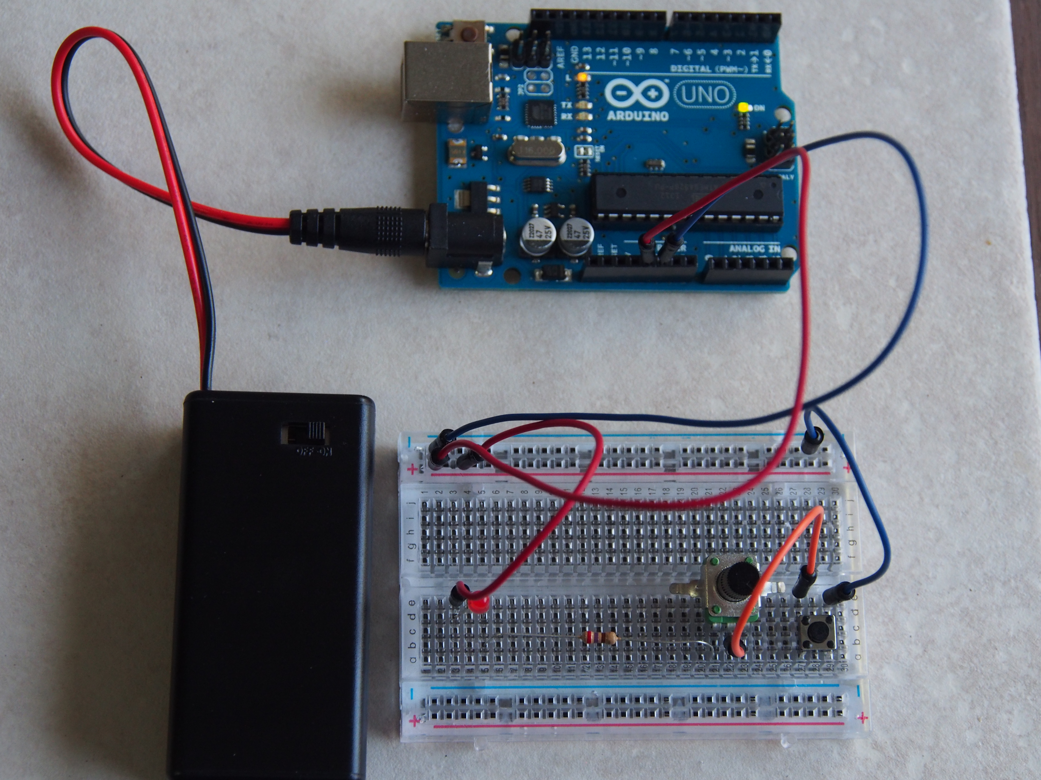
What will it look like?

Slide 10
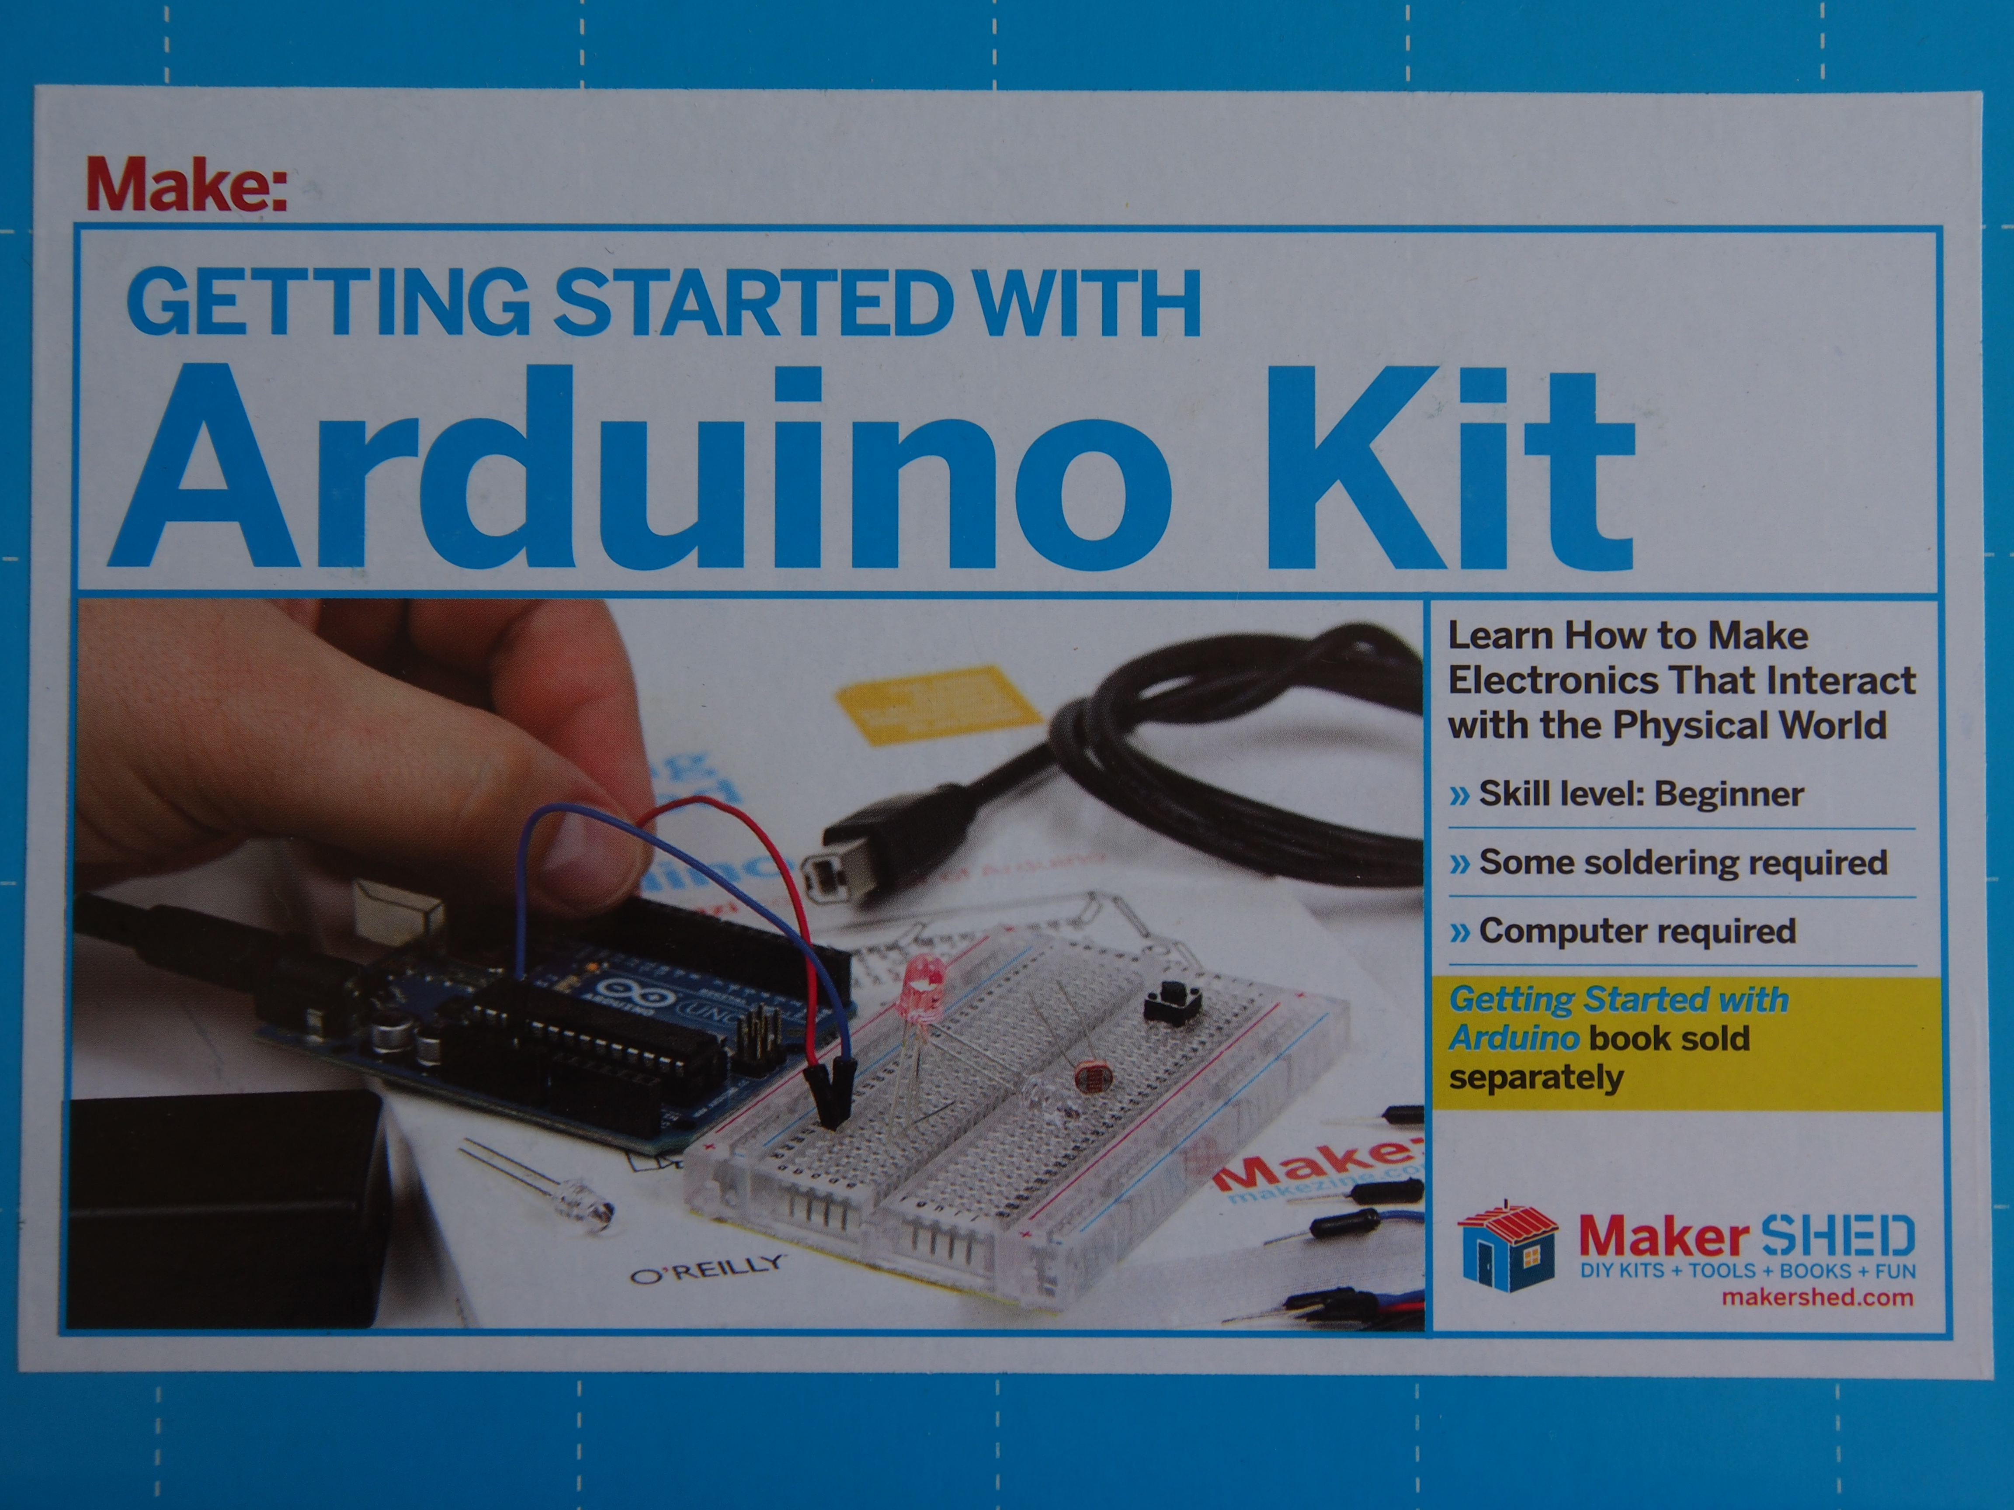
We will be using …
And
9 Volt battery
Variable resistor
Arduino software
Laptop

Slide 11
Step 1: Assemble the components on the breadboard
Notes:
+ 10 m
30 minutes for Activity #1

Slide 12
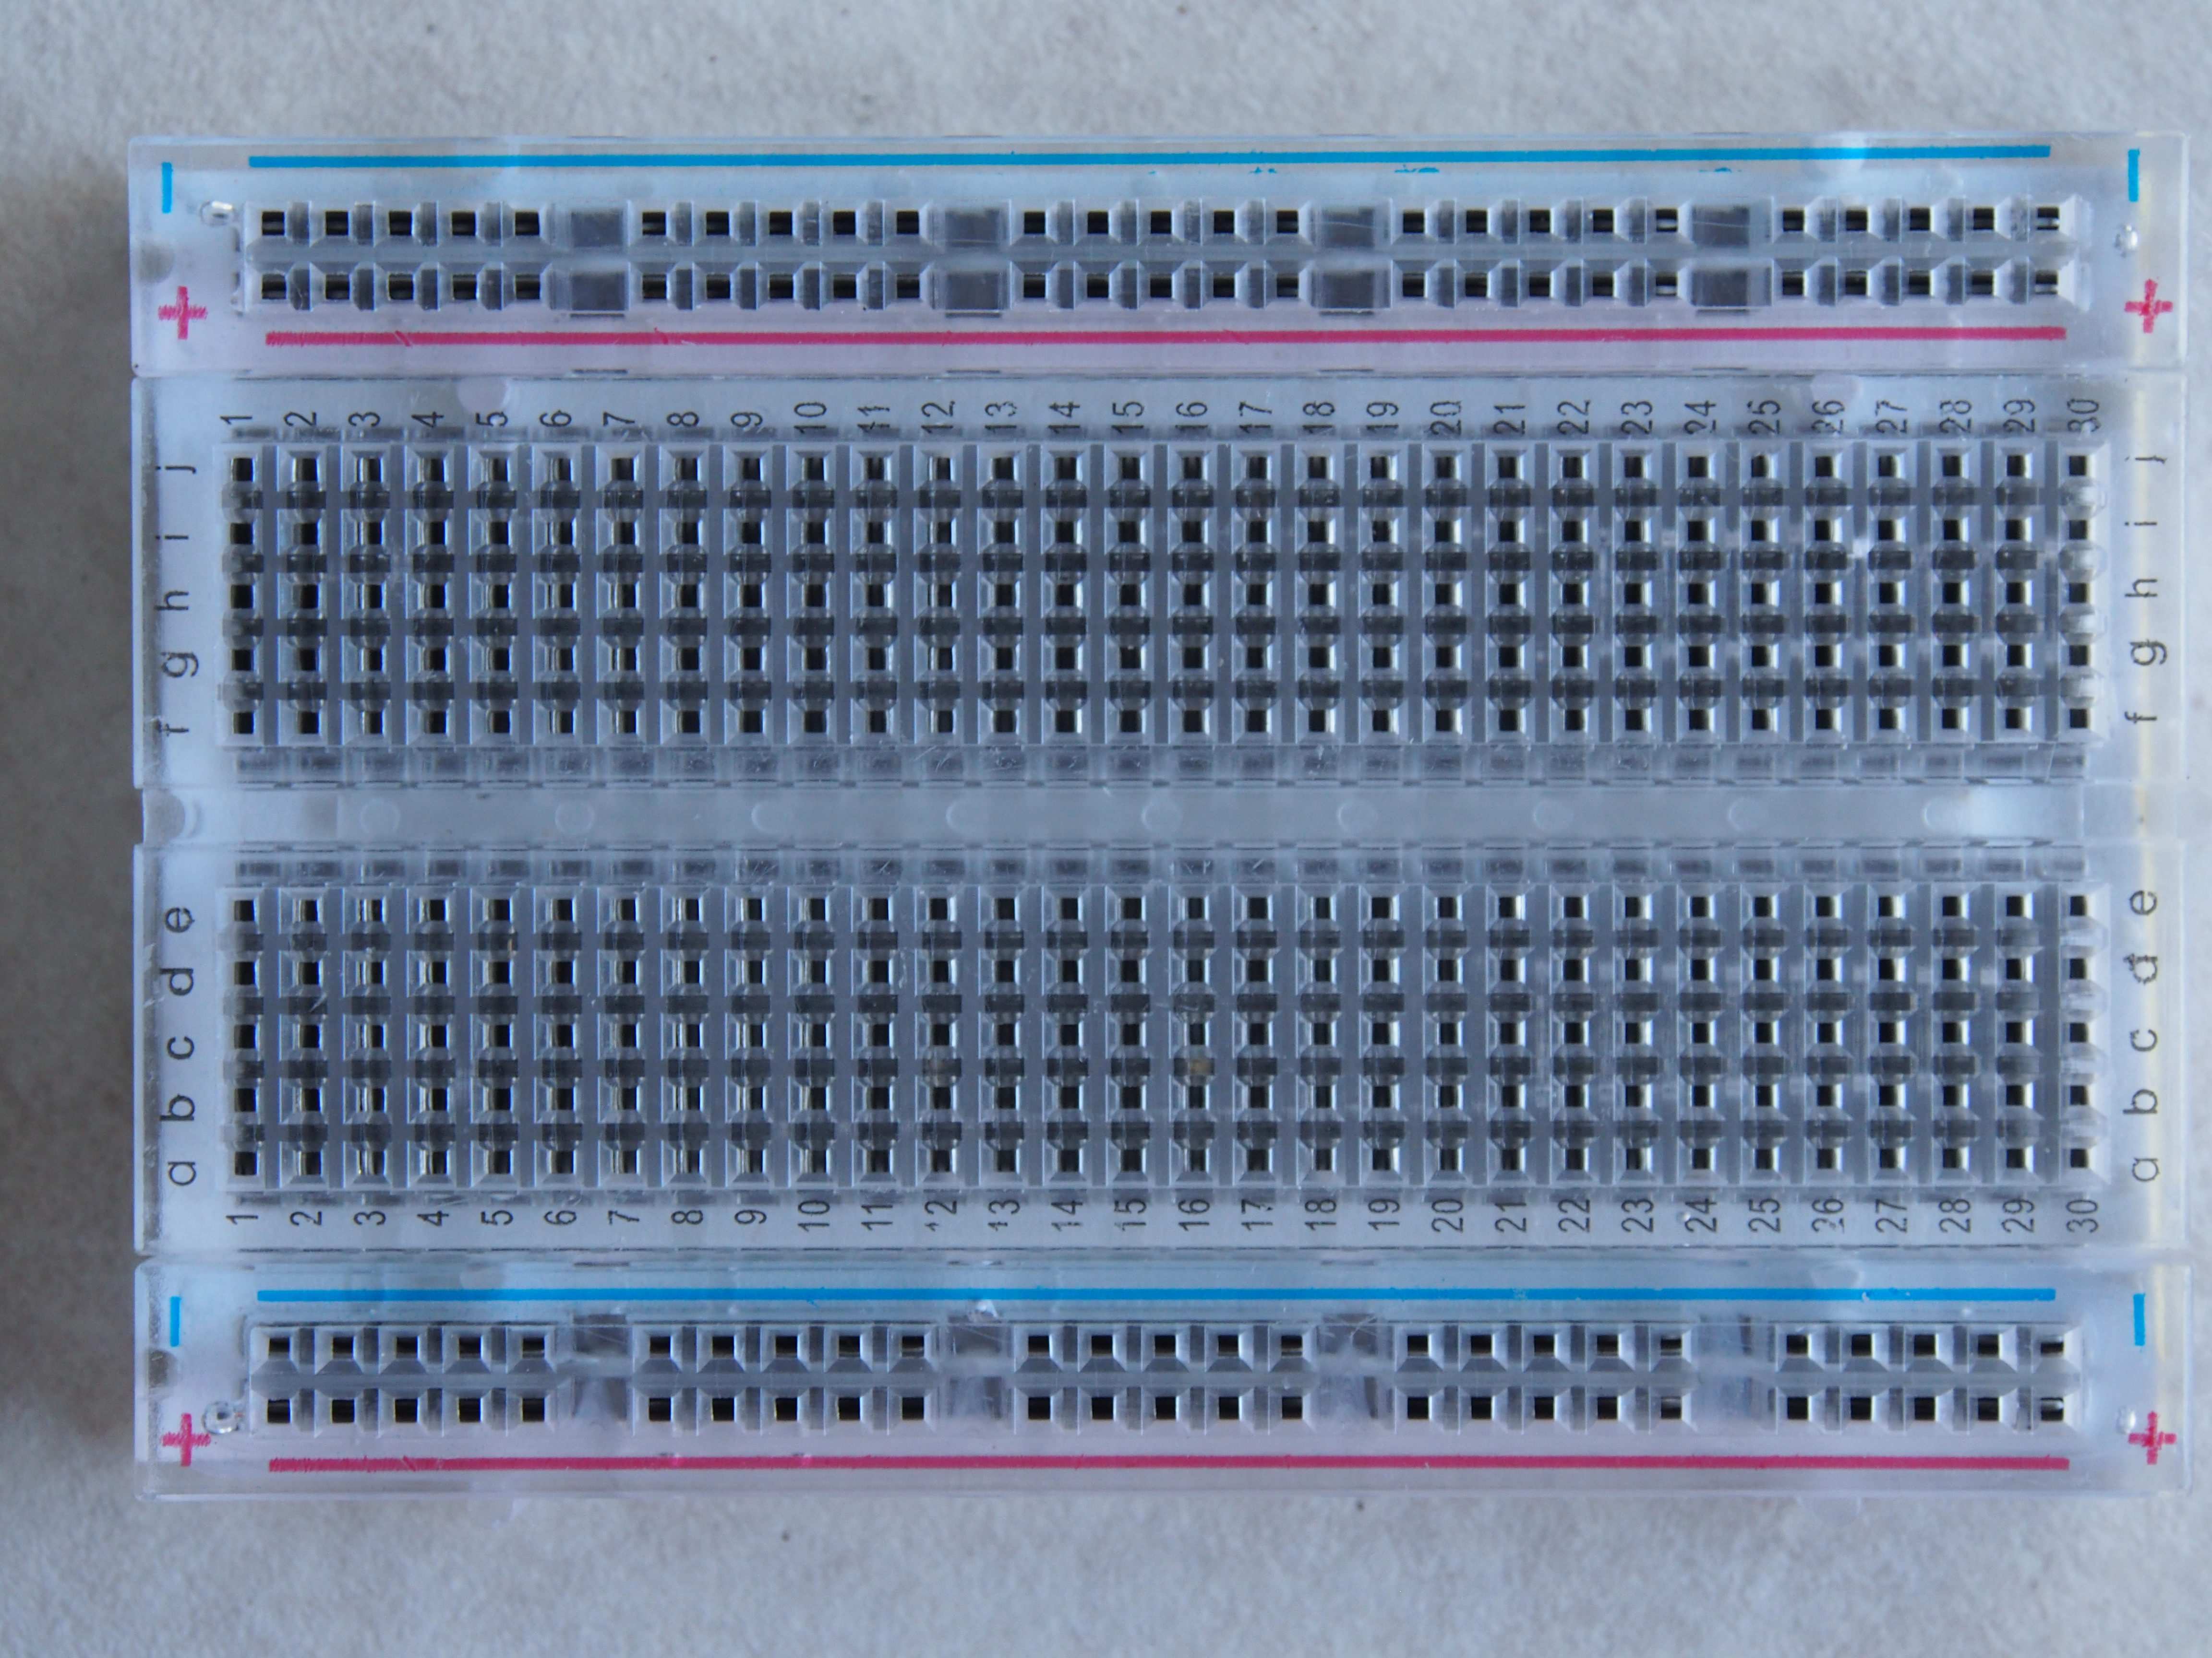
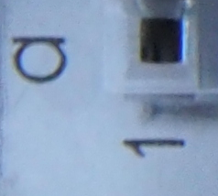
How are holes identified on the our breadboard?
Power rail #1
Negative or Minus or - Rail
Positive or Plus or + Rail
Hole a1
Row a, Column 1
Power rail #2

Slide 13
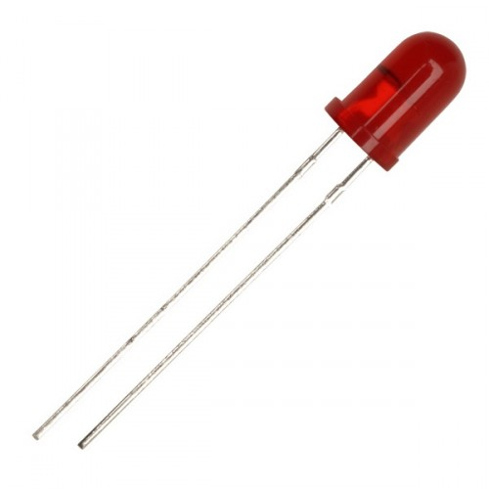
Pick a LED
long leg
short leg

Slide 14
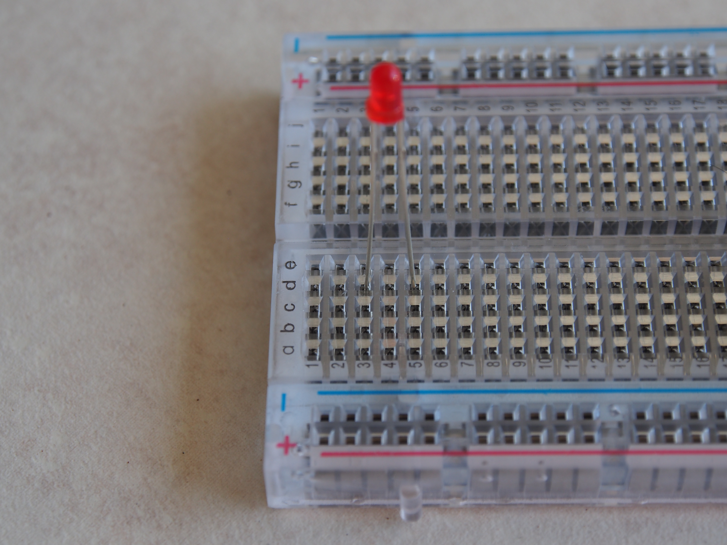
Insert LED on breadboard
+ Rail inward
Insert long leg in d3
Insert short leg in d5

Slide 15
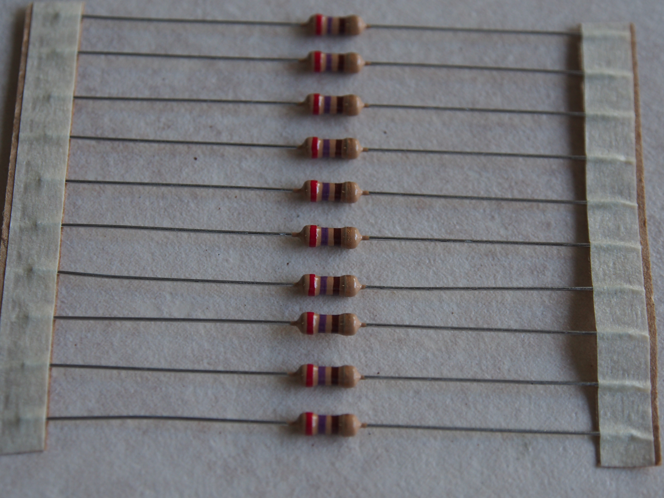
Pick a 270 Ohms Resistor
Violet Ring
Red Ring
Brown Ring

Slide 16
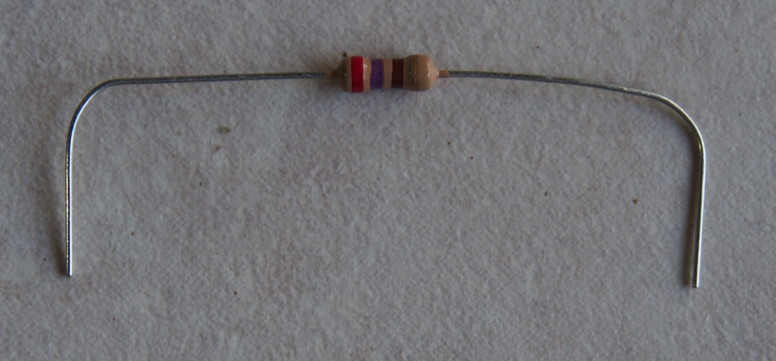
Bend and insert the 270 Ohm resistor
Insert one leg in a5
Insert other in a21

Slide 17
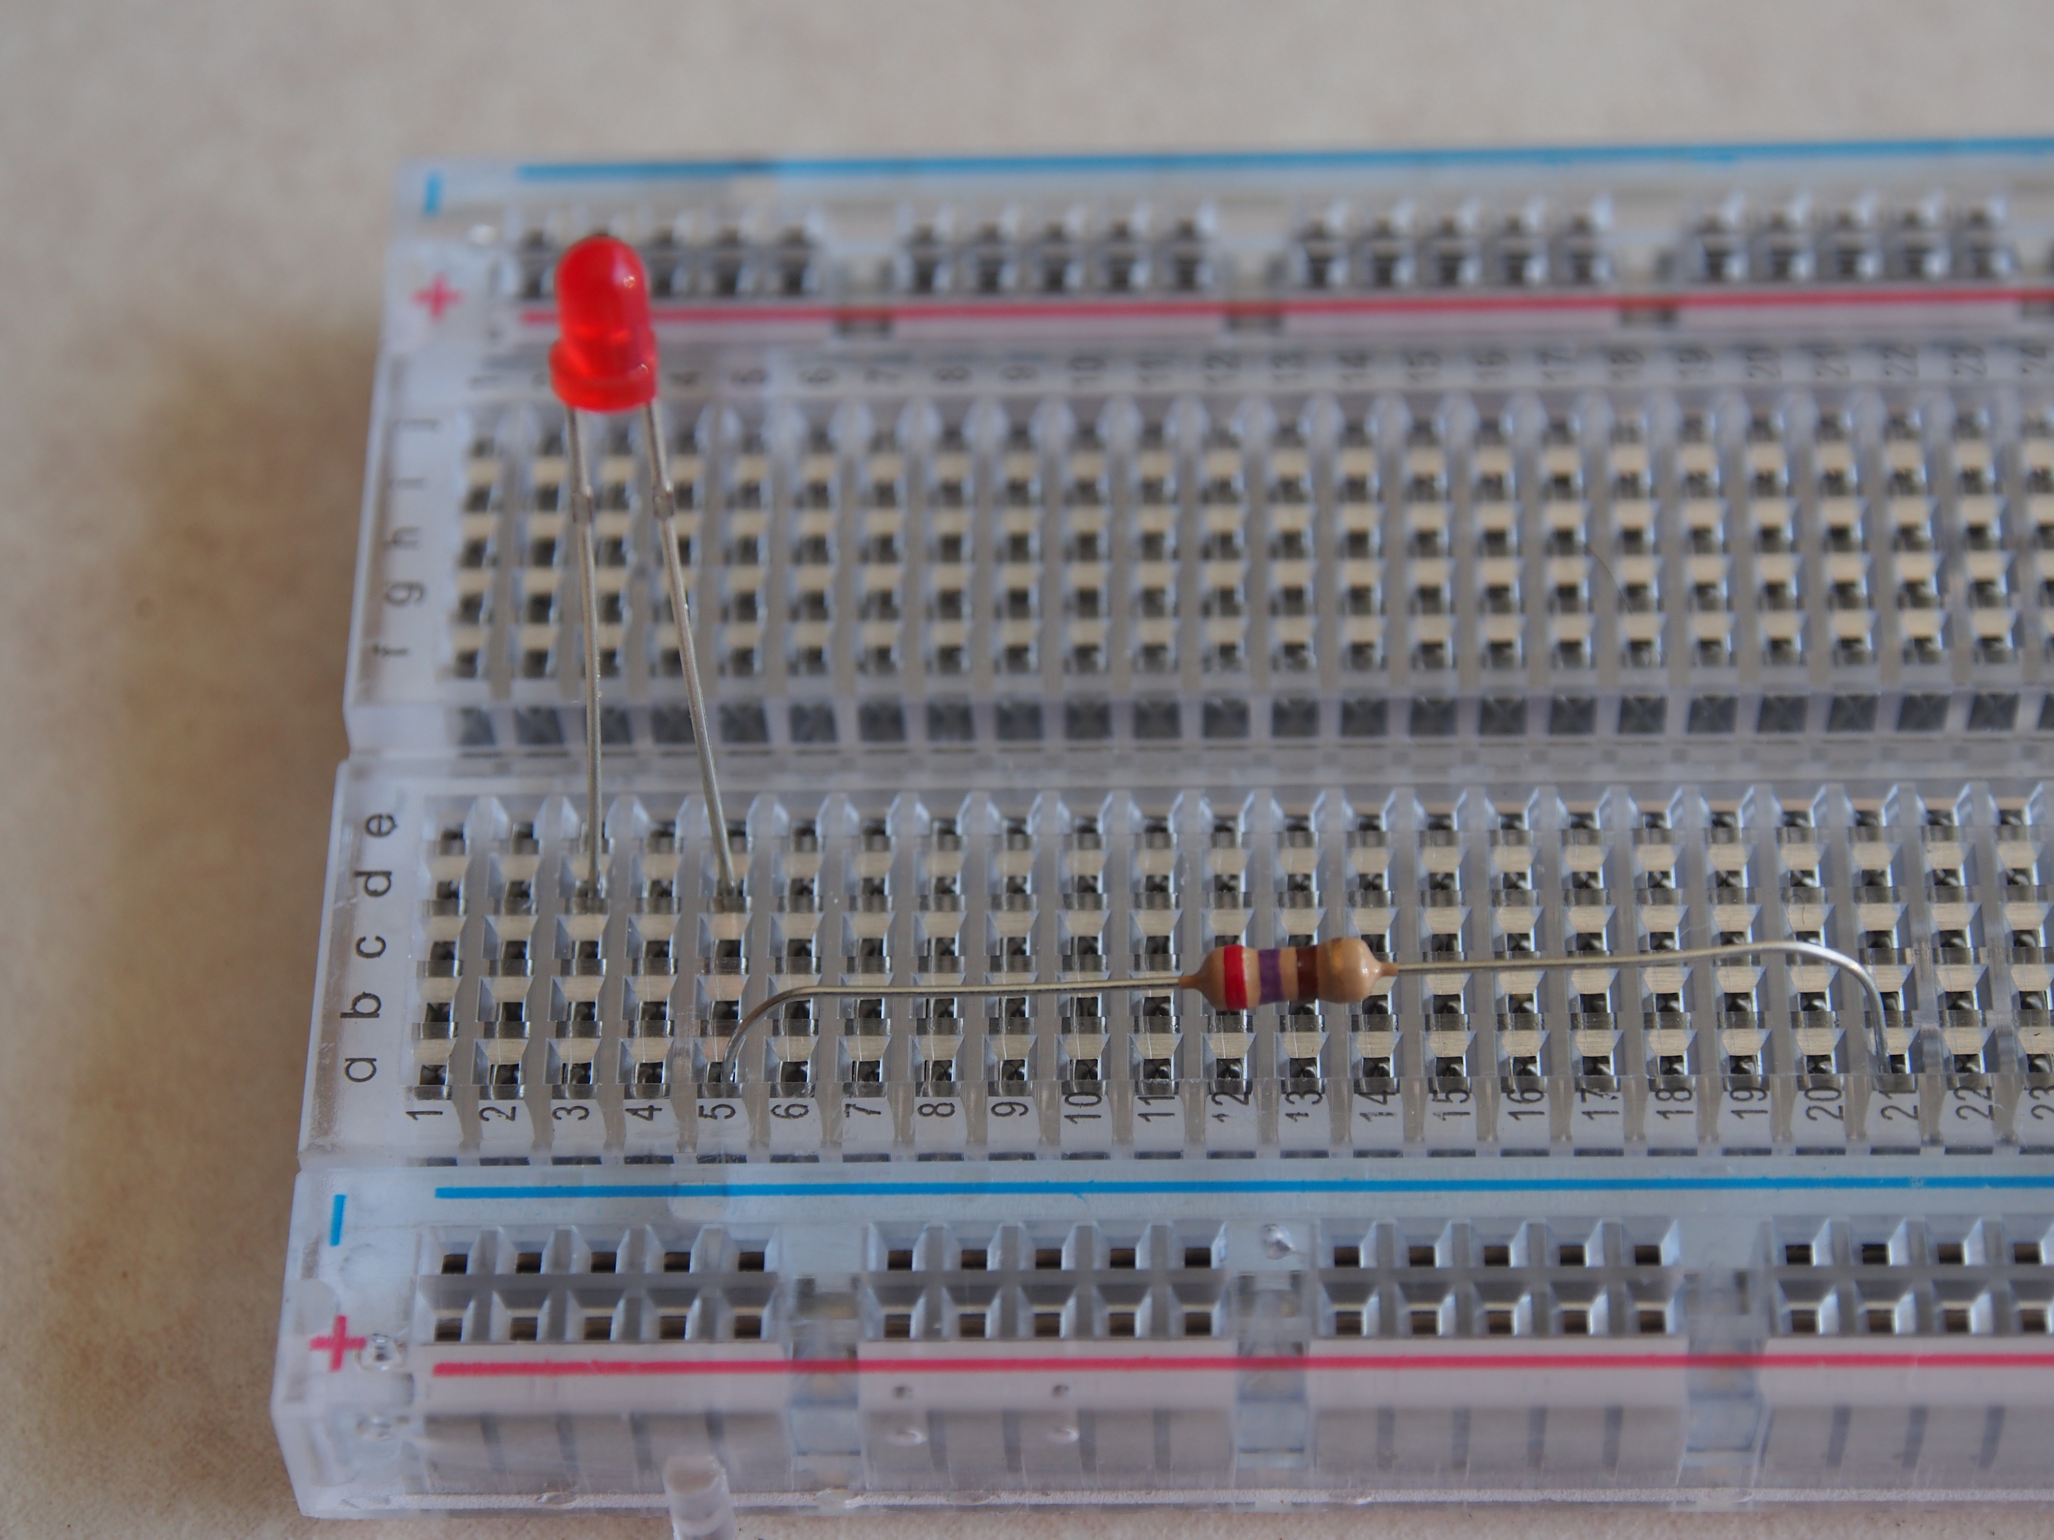
Insert one leg in a5
Insert other leg in a21

Slide 18
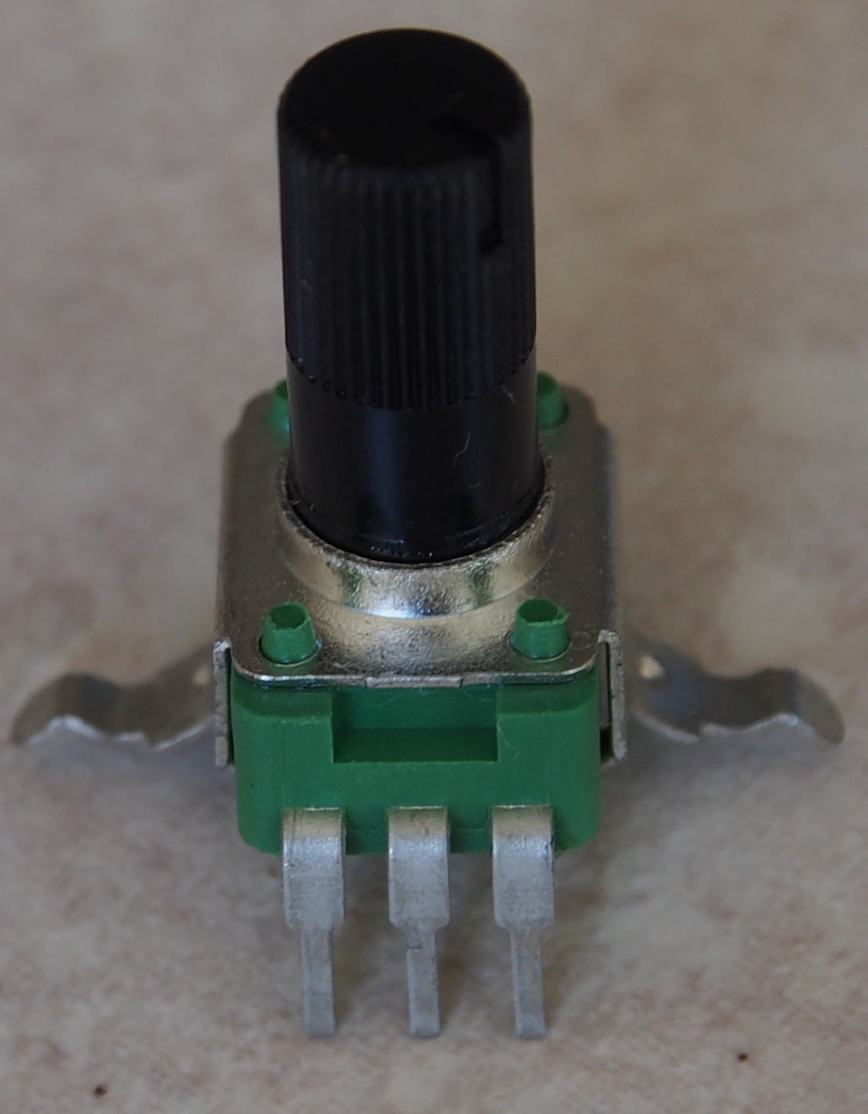
Pick the variable resistor (50K Ohm)
Right leg
Left leg
Middle leg

Slide 19
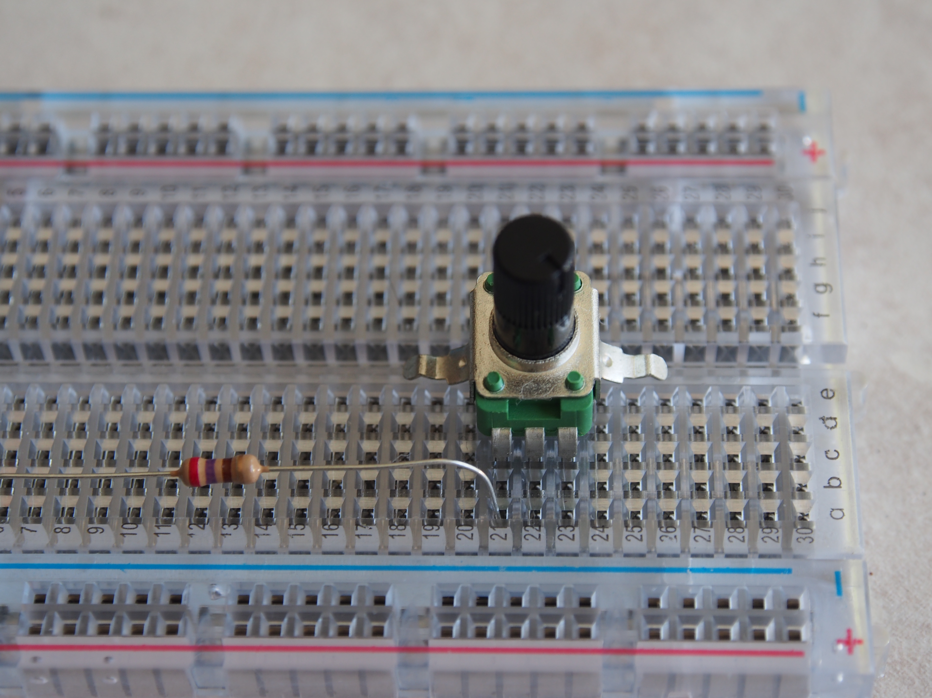
Snap the variable to the bread board. The variable resistor should hold its position once you snap it
Insert right leg in c23
Insert left leg in c21
Insert middle leg in c22

Slide 20
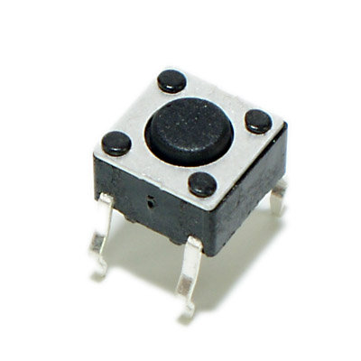
Pick in the switch and snap it on the breadboard
Insert leg A in a27
Back leg in d27
Back leg D in d29
Insert leg B in a29

Slide 21
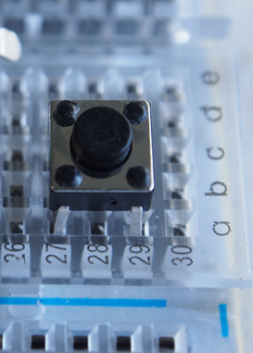
It will look like …

Slide 22
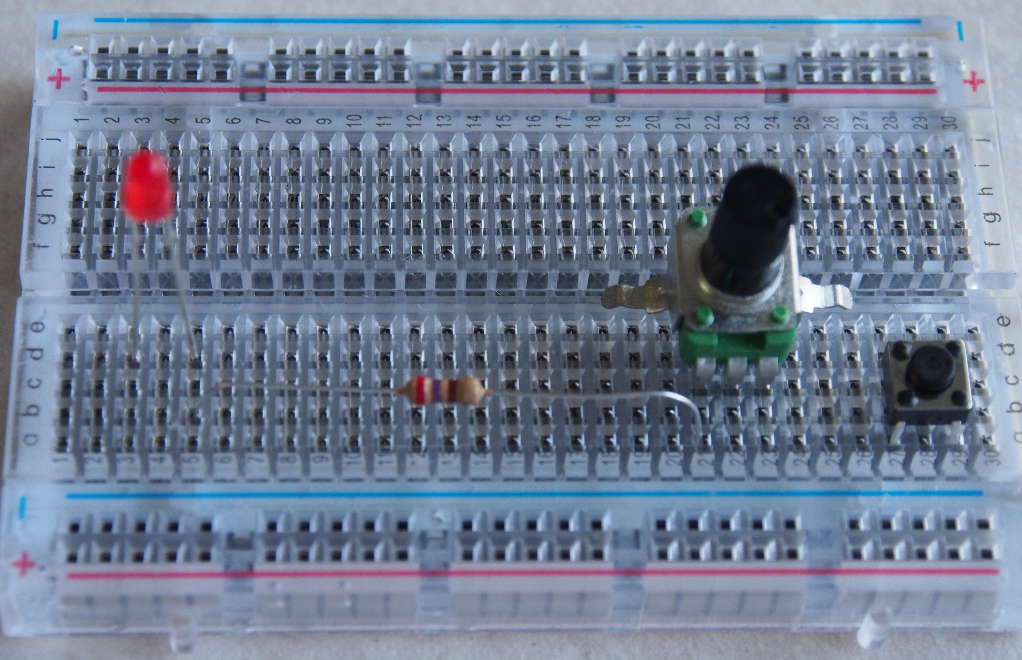
The breadboard should now look like ….

Slide 23
Step 2: Connect wires on the breadboard
> Use shorter wires for connecting components on the board

Slide 24
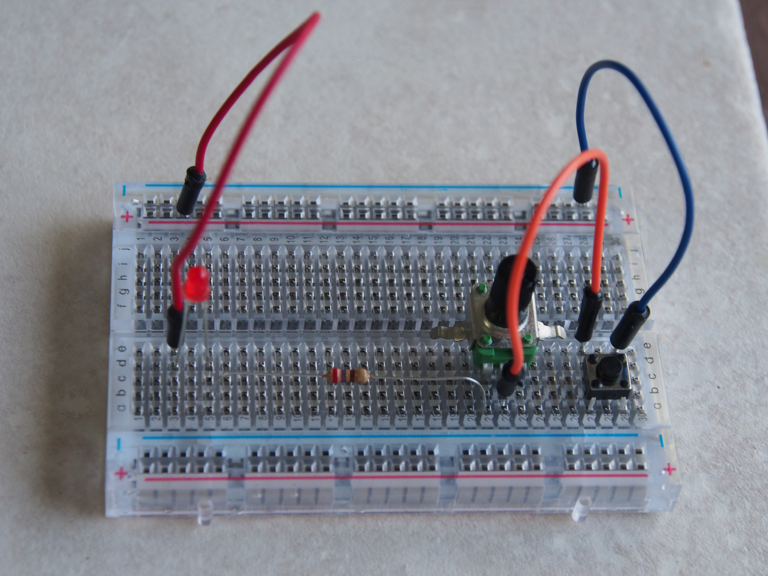
Connect Plus Rail to e3 on with red wire
Connect to Rails on the same side
Connect Minus rail to e29 with blue wire
Connect b22 to e27 with orange wire

Slide 25
Step 3: Connect wires between breadboard and Arduino
> Use longer wires for connecting the board to Arduino

Slide 26
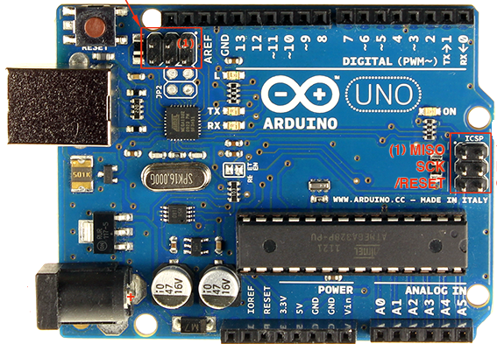
Let’s meet the Arduino again ….
Input /Output pins
Reset pin
USB
Port
LEDs
ATMega328 Microcontroller
7-12V
DC input
Power pins
Analog input pins

Slide 27
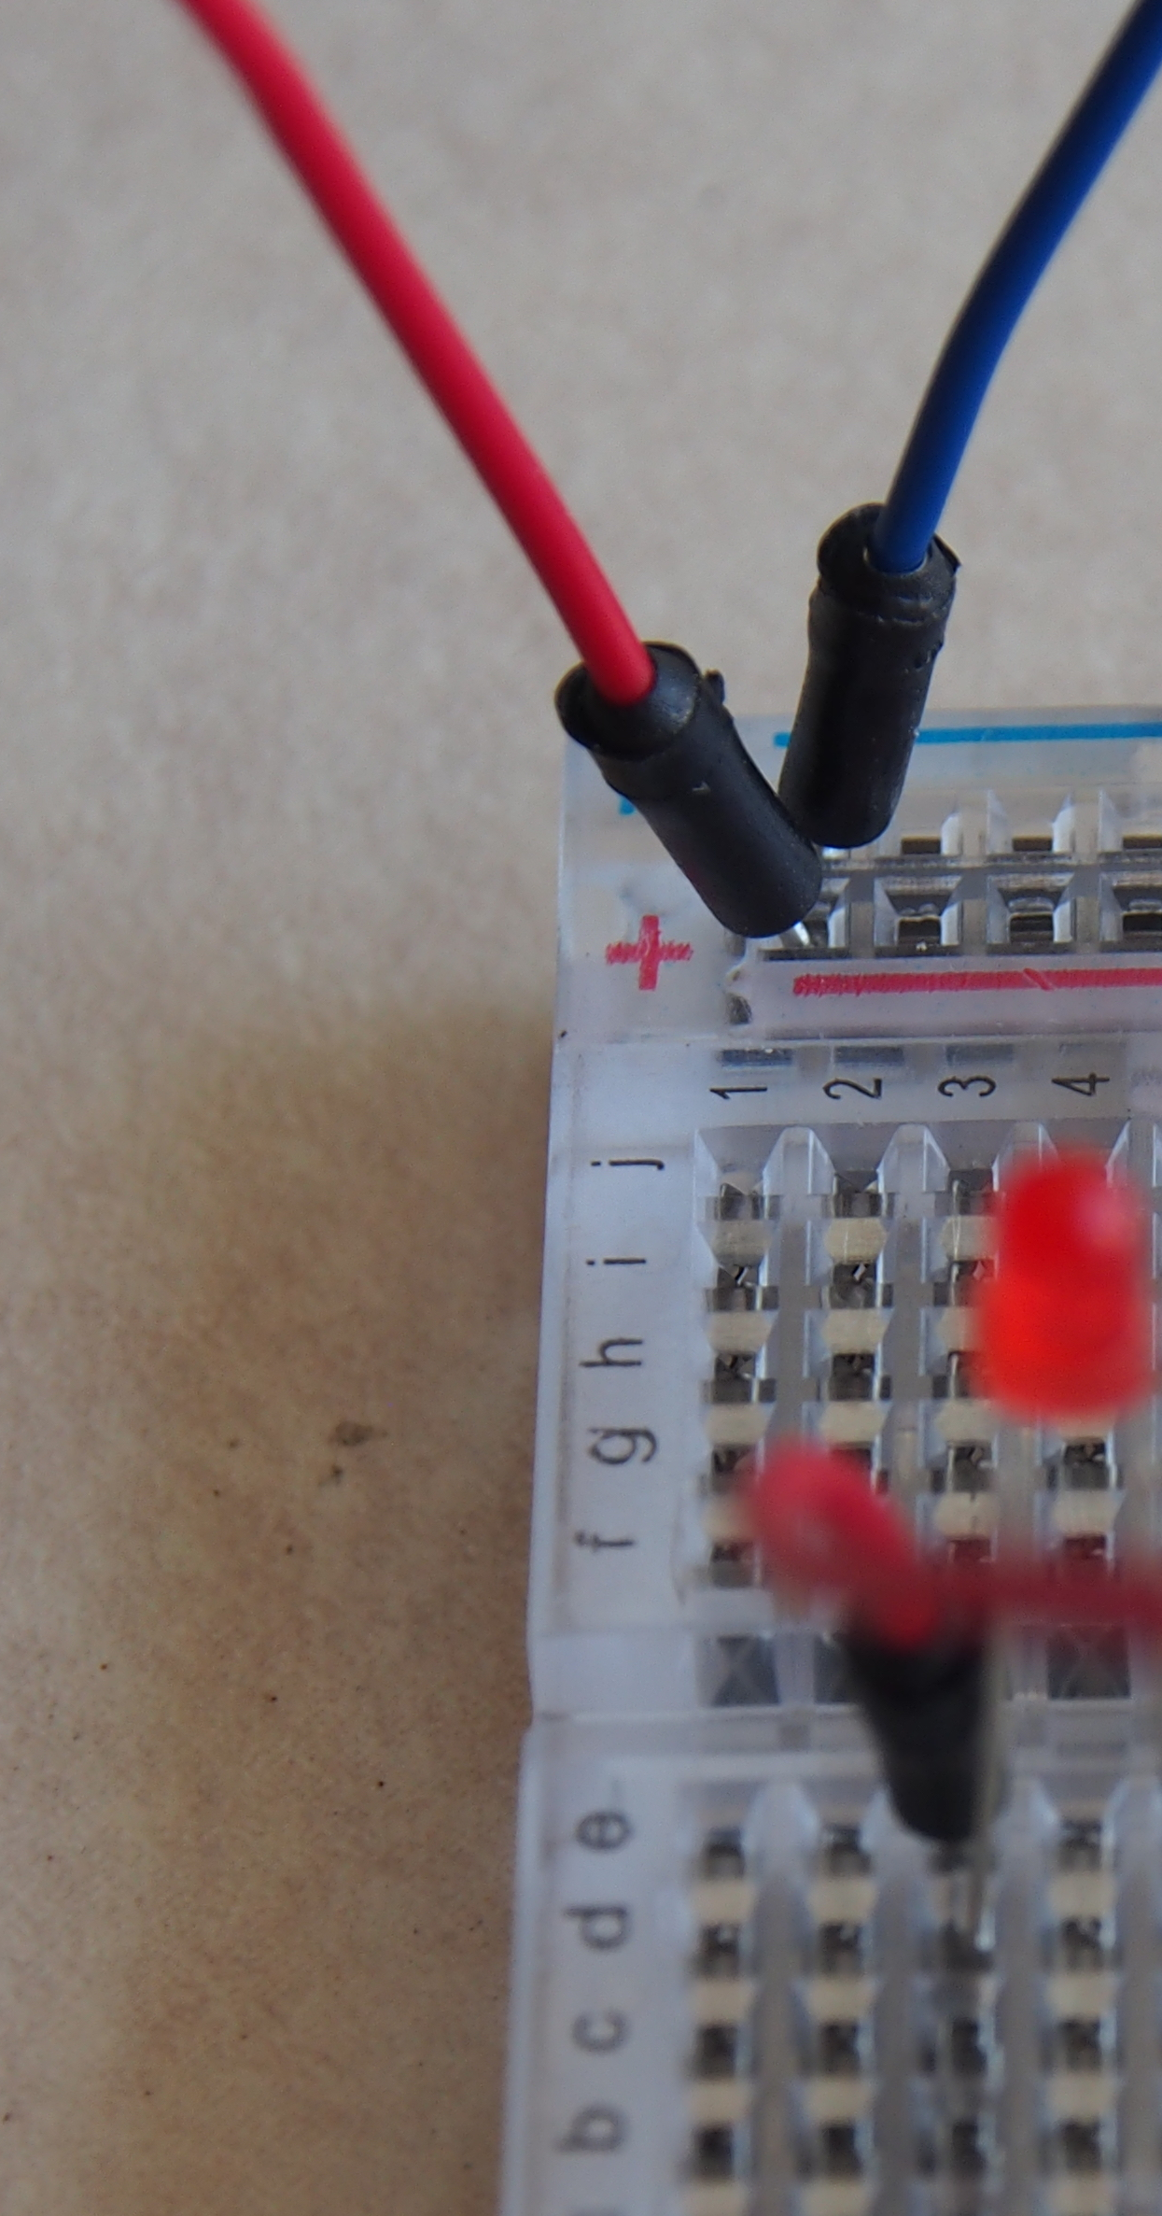
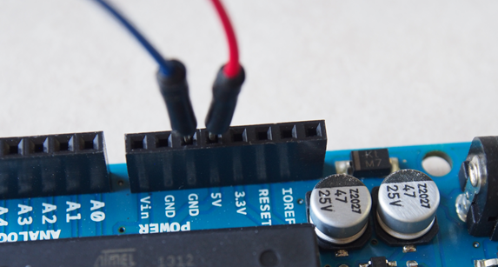
> Connect GND Pin on Arduino to Minus Strip of Power rail on breadboard using a blue wire
> Connect 5V Pin on Arduino to Plus rail on breadboard using red wire

Slide 28
Step 4: Connect battery to Arduino
> Battery Connector

Slide 29
What have we got?

Slide 30
Show time!
Turn on the Battery to “On” by sliding the switch on the battery box to “ON”.
Is the small LED on the Arduino glowing?
Press the switch. Did the LED glow?
Turn the brightness control, while keeping the switch pressed. Did the brightness change?

Slide 31
Steps we followed for activity #1
Step 1: Assemble the components on the breadboard
Step 2: Connect wires on the breadboard
Step 3: Connect wires between breadboard and Arduino
Step 4: Connect battery to Arduino
Step 5: Play

Slide 32
Time for Arduino to take a break
Switch off the battery by sliding the switch to off
Disconnect the battery from Arduino
Why?
Remove all components from the bread board except the LED and resistor – we will use them in second activity.

Slide 33
Let us meet the components ….

Slide 34
I am battery
> I push the electrons or “electric charge”
> The push is also called Voltage and is measured in Volts.
Notes:
Low voltage
Never play with the main outlets

Slide 35
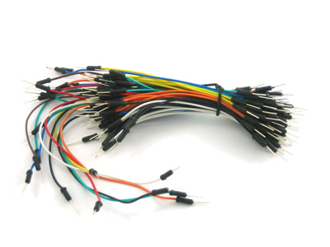
I am wire
> I am the pipe thru which electrons flow from one component to another.
> I do not change the flow/ offer resistance.
> What ever voltage is one end, it gets transferred to the other end.
> Color of the insulation does not change what I do!
> Color can help identifying what signal I have, if you follow convention. For example, red color in usually the +ve voltage while black is Ground.

Slide 36
I am L-E-D
> An LED is a very small light, often colored (white / red / yellow / green)
> Each LED has two legs ... a short and a long
> Long is the PLUS (+) (positive pole)
> It glows when current flows
> It can handle only small amount of current
> Short ... MINUS (-) (Negative pole)

Slide 37
I am “Push for On” switch
> I let current pass when you press me.
> I do not let any current to flow when I am left alone.

Slide 38
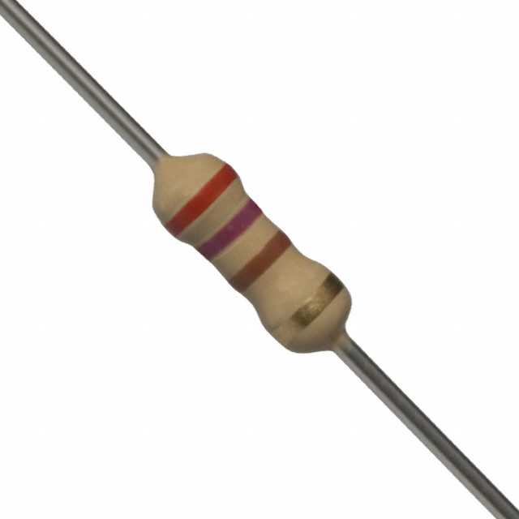
I am resistor
Violet (7)
Ring
Red (2)
Ring
Brown (1)
Ring
> I offer resistance to the flow of current
> The amount of resistance I offer is fixed.
> The amount of resistance I offer is measured in Ohms. Sometimes people prefer to use Kilo and Mega Ohms to keep the numbers small and easily readable
> The amount of resistance I offer is identified by the colors of the rings on me.
2 7 0 Ohms
Notes:
Try the scratch

Slide 39
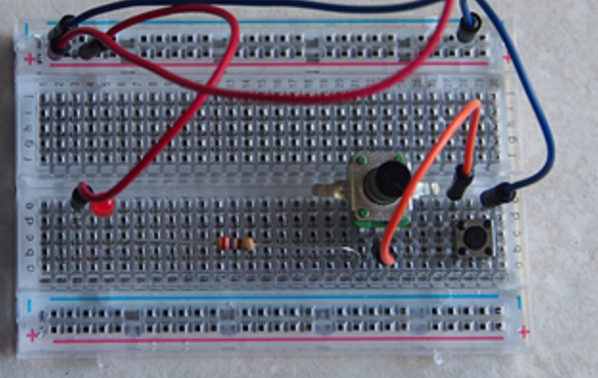
I am breadboard
> Here are some connections I made for you
d5 to a5
a21 to c21
c22 to b22
e27 to d27
e29 to d29
> I make connection, just like wires
> You do not make these connections and you do not see them
Notes:
Try the scratch

Slide 40
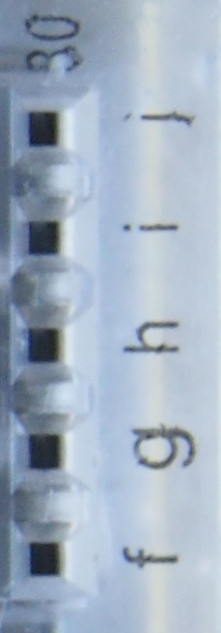
How do I make the connections?
Power rail
Terminal
Strip

Slide 41
How much is my resistance?
A
Second Digit
B
First Digit
Multiplier
C
Tolerance
D

Slide 42
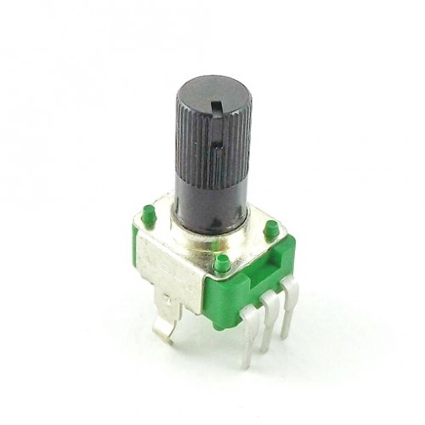
I am the variable resistor
> Resistance between the middle terminal and either of the two end terminal depends upon where the know is turned.
> The amount of resistance is somewhere in between fixed resistance and zero.
> I offer fixed resistance between the two end terminals.
> I have three terminals

Slide 43

Circuit, conductor and insulator

Slide 44
Circuit
> Circular path through which electricity can flow.
> Needs a battery or source of electricity that can make the electricity flow through it.
>Something interesting like a LED, which does something when electricity flows.

Slide 45
Electric push (Voltage)
> Voltage is the push for the charge to flow
> Voltage is measured in Volts
> Volts is shown as ‘V’ in diagrams

Slide 46
Electric Current
> Current is the flow of electric charge
> Current is measured in Ampere
> Ampere is shown as Amp or A in diagrams
> Smaller unit of current is milli Ampere (or mA).
> 1000 milli Ampere = 1 Ampere

Slide 47
Zoooooooming into matter …
-
N
+
N
+
-
Electron
N
Neutron
-
+
Proton
Notes:
+ 45-55 minutes
Skip section on theory

Slide 48
Flow of electrons…
-
-
-
-
+
-
+
+

Slide 49
Ohm’s Law
If we increase the resistance in the circuit, less current will flow thru it.
Provided we do not change the voltage ( push).
Notes:
Check out the scratch

Slide 50
Ohm’s Law
If we increase the push(voltage) applied to the circuit, more current will flow thru the circuit
Provided we do not change the resistance

Slide 51
Ohm’s Law
Voltage drop across a component is the amount of current flowing through it and multiplied by the resistance offered by it.
V = I * R

Slide 52
What do we use Ohm’s law for?
> LED manufacturer says: “This LED may be damaged if current above 10 milli Amps flows thru it. The voltage across the red LED will be 2 volts when it is glowing.”

Slide 53
The circuit diagram
5 Volt
50 kΩ
270 Ω
… in the language of the engineers !

Slide 54
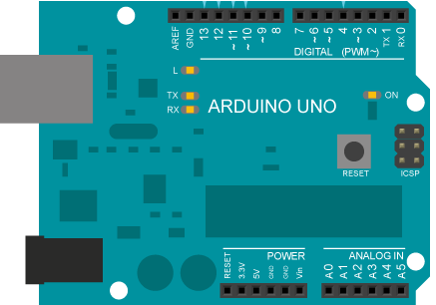
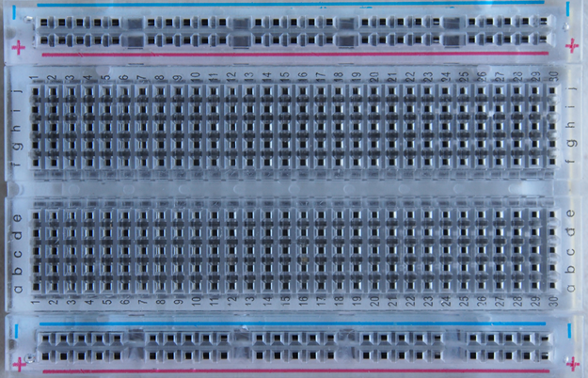
The wiring diagram
9 Volt
Long leg
Variable
resistor
LED
5V
GND
270 Ω
LED

Slide 55
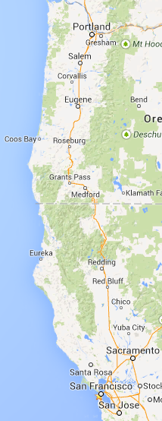

Which picture will you use to help a friend drive from Redwood City to Mountain View?

